Slide 1
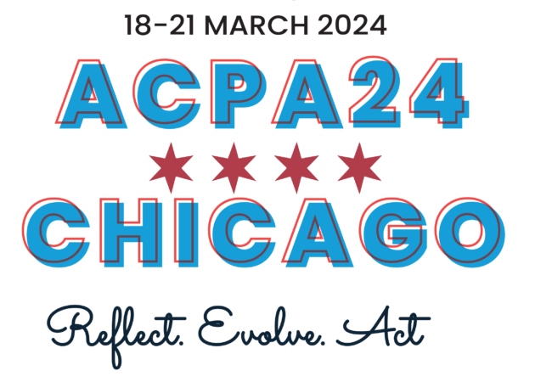
Presentation Title
Presentation Subtitle Fonts: Verdana Regular & Bold
Presenter // Presenter Info
Presenter // Presenter Info

Slide 2
ACPA LAND ACKNOWLEDGEMENT
ACPA–College Student Educators International acknowledges that our ACPA24 Convention is taking place on the traditional unceded homelands of the Council of the Three Fires: the Ojibwe, Odawa, and Potawatomi Nations and the Illinois Confederacy: The Peoria and Kaskaskia Nations. Many other tribes, such as the Miami, Ho-Chunk, Menominee, and Sac and Fox, also called this area home. The region has long been a center for Indigenous people to gather, trade, and maintain kinship ties. Today, one of the largest urban American Indian communities in the United States resides in Chicago. Members of this community continue to contribute to the life of this city and to celebrate their heritage, practice traditions, and care for the land and waterways. We acknowledge that we are on occupied land that was forcibly taken and we affirm that while we cannot change history, we can work for justice.

Slide 3
ACPA LAND ACKNOWLEDGEMENT (CONTINUED)
Beyond acknowledging the land and in recognition of modern and historical settler colonialism, including that perpetuated by North American institutions of higher education, ACPA actively commits to supporting Higher Education in decolonizing their practice and scholarship through our mission, values, and the Strategic Imperative for Racial Justice and Decolonization.

Slide 4
OUR LAND ACKNOWLEDGEMENT
Presenters, please insert your prepared Land Acknowledgement here.
Visit the Presenter Resources webpage on the ACPA23 website for information and resources on preparing a Land Acknowledgement.
*all content must fit in white space only

Slide 5
INCLUSIVE LANGUAGE
ACPA24 provides an opportunity to discuss concepts that span a variety of audiences and contexts in higher, post-secondary, and tertiary education.
As such, we ask that session participants:
Recognize individual gender pronoun use
Utilize contemporary and relevant language around social identities
Utilize language that recognizes varying abilities and is not ableist
Utilize language inclusive of diverse global contexts
Utilize this space for developmental and educational support of attendees who may be unfamiliar with inclusive language practices

Slide 6
Heading 1
Body Content (Verdana, 20pt, #341354)
Presenters, insert your presentation here.
*all content must fit in white space only – the space at the bottom is reserved for captioning

